Slide 1

THE INDUSTRY LEADER IN REMOTE MONITORING & CONTROL
RAD eX

Slide 2
THE PROBLEM
You may need AC mitigation disconnected for a survey, but you don’t always have days—or even weeks—to coordinate field crews, schedules and site access. Traditional manual disconnects introduce delays that can stall critical work and create operational bottlenecks. Beyond the time constraints, several additional risk factors come into play, including:
1
Increased risk to employees being out in the field
4
Increased costs on company assets & vehicles
2
Time & risks that arise from traveling to remote sites for multiple hours for each event
5
Coordinating multiple work orders & techs takes time, in itself
3
Each manual disconnect event can take hours, costing your company more

Slide 3
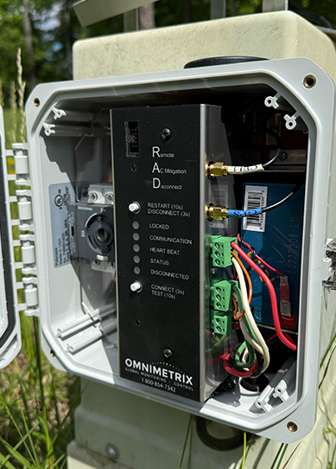
MEET THE RAD eX
RAD eX transforms AC mitigation systems from passive infrastructure into fully remotely managed assets—reducing field exposure, lowering operating costs, and improving the execution of integrity programs.
RAD eX communicates wirelessly through cellular or satellite networks, enabling remote control of any SSD or PCR connected to the AC mitigation system. With the ability to command one—or multiple—RAD eX units simultaneously with a single click, organizations eliminate the need for technicians to manually disconnect equipment in the field, dramatically improving efficiency and safety. No manual intervention, no field visit, no delay.

Slide 4
WHY RAD eX?
Avoid the dangers and inconvenience of manually disconnecting an SSD or PCR. What once required days—or even weeks—of scheduling, travel and field work now takes only seconds with RAD eX. A single remote command replaces the need for multiple site visits, dramatically improving safety, efficiency and operational responsiveness.
1
3
Increase employee safety
Programmable disconnect/connect dates and times
2
4
Control one (1) to many SSD/PCR’s at once
Reduce expenditures and employee costs

Slide 5
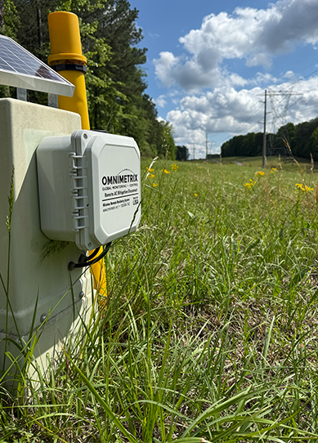
RAD eX FEATURES
This next‑generation Remote AC Mitigation Disconnect delivers all the standard RAD capabilities—and adds a powerful suite of advanced features designed to further enhance safety, efficiency and system intelligence. In addition to the core functionality you rely on, RAD eX provides:
1
DC Pipe Voltage
2
DC Pipe Current
3
DC Current Density
4
AC Pipe Voltage
5
AC Pipe Current
6
AC Current Density

Slide 6



RAD eX BENEFITS
TECHNICIAN SAFETY
By eliminating the need to send technicians into the field, RAD eX removes a wide range of operational and safety hazards by enabling remote control of AC mitigation systems. When touch voltage exceeded 15VAC, or the company defined threshold, the unit(s) automatically re-closes on its own, generates an alarm, and can be easily reopened via our app or web portal Faster response, improved overall safety performance, fewer truck rolls, lower operation costs and greater peace of mind for field teams.
LIABILITY
Having technicians in the field inherently increases organizational liability. Whether they’re working around high‑voltage AC infrastructure or navigating road hazards and traffic while traveling between sites, every trip and every on‑site interaction introduces risk. By allowing teams to operate AC mitigation assets without physically visiting each location, RAD eX minimizes electrical‑contact hazards, eliminates unnecessary travel and reduces the overall likelihood of safety‑related incidents.

Slide 7


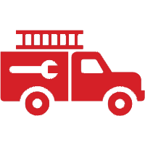
RAD eX COST SAVINGS
TECHNICIAN EXPENSES
The additional time required for technicians to physically travel to each site also drives up labor costs. When you factor in an average labor rate of $40 per hour, even small increases in weekly travel time compound quickly. For example, an extra 3 hours of driving per day results in 15 additional hours per week spent simply getting from point A to point B. At $40/hour, that equates to $600 per week, or $31,200 in annual labor expense per technician—costs that can be avoided by using the RAD eX’s remote monitoring and control capabilities.
TRUCK ROLL EXPENSES
Requiring technicians to physically visit each site also accelerates wear and tear on company vehicles. Every additional trip contributes to higher fuel consumption, more frequent routine maintenance, increased likelihood of repairs and faster depreciation. By shifting to a remote monitoring and control solution like RAD eX, organizations can significantly reduce unnecessary mileage, extend vehicle lifespan and avoid the cascading costs associated with heavy field‑use of fleet assets.

Slide 8



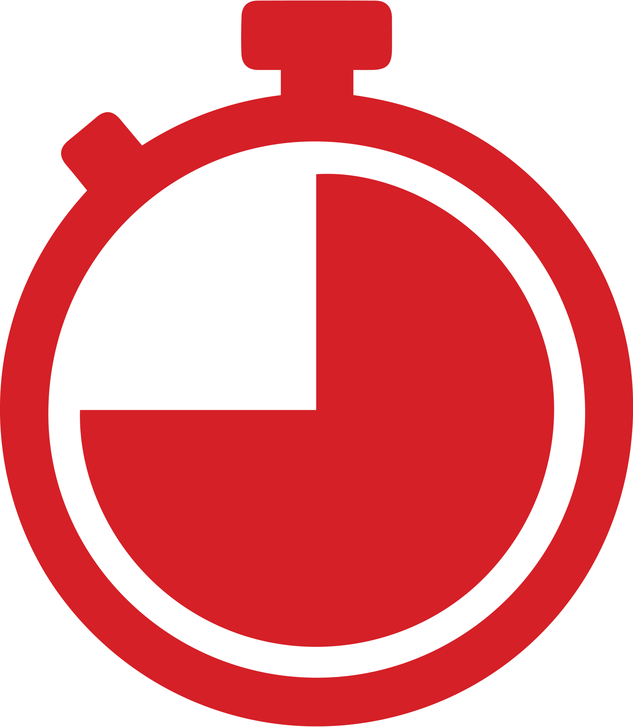
RAD eX COST SAVINGS
OPPORTUNITY COST
Opportunity cost is one of the most overlooked yet impactful elements of RAD eX’s value. What surveys, locates or maintenance tasks are being delayed because technicians are tied up traveling between sites? Every hour spent driving to disconnect AC mitigation is an hour not spent on higher‑priority work. By eliminating these low‑value travel hours, RAD eX frees technicians to focus on revenue‑critical activities, inspections and time‑sensitive operational needs—work that directly benefits the organization instead of being lost to windshield time.
SAVE TIME
EVERYTHING IN ONE PLACE
Choose to open one, to all, AC Mitigation Pedestals through a web command sent from your office vs. sending techs to individually open AC Mitigation Pedestals one at a time in the field.
Know the status of your AC Mitigation Pedestals (Connected/Disconnected with AC values for both) at a glance. No matter how large the system.

Slide 9
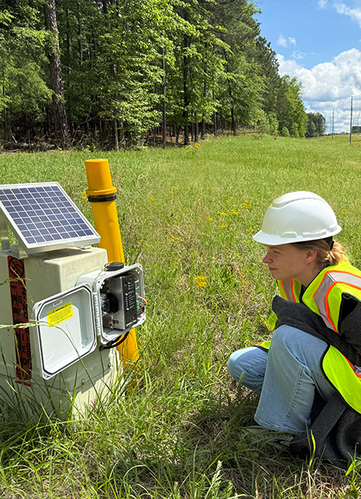
REMOTE MONITORING BENEFITS
INSTANT SYSTEM‑WIDE VISIBILITY
See the status of every AC Mitigation Pedestal—Connected or Disconnected—along with real‑time AC values for both states, all at a glance, regardless of system size.
CUSTOMIZABLE HOME DASHBOARD
Prioritize the metrics and views that matter most to you. Build a dashboard tailored to your workflow and operational needs.
SMART NOTIFICATIONS
Receive email and text alerts for the events you care about, ensuring you’re always informed without being overwhelmed.
SCHEDULE FROM ANYWHERE
Create and manage disconnect/reconnect schedules remotely, enabling precise timing and eliminating the need for on‑site coordination.

Slide 10
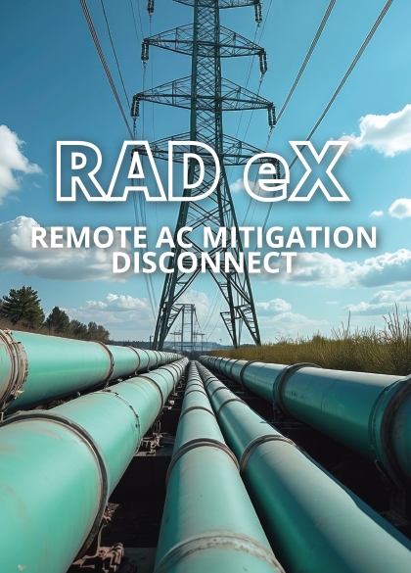
REMOTE MONITORING BENEFITS
FLEXIBLE SCHEDULING FOR ONE OR ALL UNITS
Schedule a disconnect for any single RAD eX or the entire fleet. Set a start date/time and an end date/time, ensuring AC mitigation is automatically re‑enabled whenever testing is not taking place.
ONE‑CLICK SYSTEM CONTROL
Connect or disconnect one—or all—RAD eX units simultaneously with a single remote command, eliminating the need for manual, site‑by‑site action.
DAILY PIPE CHECK
Apply this feature to one or all RAD eX units to automatically capture a daily Pipe AC Disconnected reading. The check can be scheduled at any time during daylight hours, providing consistent, reliable data without requiring a field visit.

Slide 11
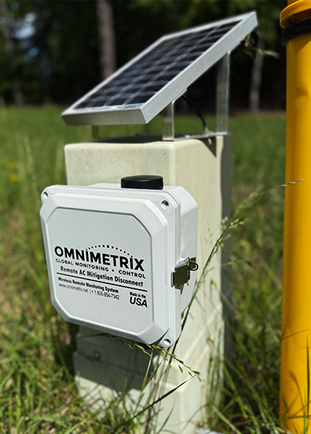
WHY OMNIMETRIX?
PIONEERING
SINCE 1998
WHERE INNOVATION
MEETS AGILITY
OmniMetrix is the gold
standard for monitoring & control solutions. Tailored products with unmatched flexibility.
• Trailblazing technology
• Forward thinking leadership
• Big enough to handle any job
but small enough to remain nimble
UNMATCHED
SUPPORT
FLEXIBLE, SCALABLE
TAILORED SUPPORT
OmniMetrix is committed to
providing expert assistance during your entire ownership cycle. Our main focus: ensure this highest level of unmatched support.
• Comprehensive communication
• Adaptive support structure
• Experienced & versatile
US-based support model

